Slide 1
CPSC 483 Decision Trees
Anand Panangadan
apanangadan@fullerton.edu

Slide 2
What we will cover this week
Decision trees
ID3 algorithm
CART algorithm
Entropy

Slide 3
The Data Science Process
Data Visualization
Data analysis
Exploratory Data Analysis
Formatting, Cleaning
Data integration
Storage
Data

Slide 4
Decision trees

Slide 5
What is a Decision Tree?
A predictive model based on a branching series of tests of feature values

Slide 6
Example of a Decision Tree
Given a person’s
Marital status
Income
Refund?
Decide if the person is likely to have cheated on his/her income tax return
Splitting Attributes
Refund
Yes
No
NO
MarSt
Single, Divorced
Married
TaxInc
NO
< 80K
> 80K
NO
YES
Decision Tree

Slide 7
Apply Model to Test Data
Test Data
Start from the root of tree.
Refund
Yes
No
NO
MarSt
Single, Divorced
Married
TaxInc
NO
< 80K
> 80K
NO
YES

Slide 8
Apply Model to Test Data
Test Data
Refund
Yes
No
NO
MarSt
Single, Divorced
Married
TaxInc
NO
< 80K
> 80K
NO
YES

Slide 9
Apply Model to Test Data
Test Data
Refund
Yes
No
NO
MarSt
Single, Divorced
Married
TaxInc
NO
< 80K
> 80K
NO
YES

Slide 10
Apply Model to Test Data
Test Data
Refund
Yes
No
NO
MarSt
Single, Divorced
Married
TaxInc
NO
< 80K
> 80K
NO
YES

Slide 11
Apply Model to Test Data
Test Data
Refund
Yes
No
NO
MarSt
Single, Divorced
Married
TaxInc
NO
< 80K
> 80K
NO
YES

Slide 12
Apply Model to Test Data
Test Data
Refund
Yes
No
NO
MarSt
Single, Divorced
Married
Assign Cheat to “No”
TaxInc
NO
< 80K
> 80K
NO
YES

Slide 13
From Decision Trees To Rules
Rules are mutually exclusive and exhaustive
Rule set contains as much information as the tree

Slide 14
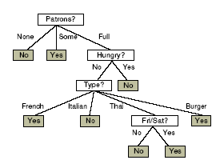
From Decision Trees To Rules
Every decision tree corresponds to set of rules:
IF (Patrons = None)
THEN WillWait = No
IF (Patrons = Full) & (Hungry = No) &(Type = French)
THEN WillWait = Yes
...

Slide 15
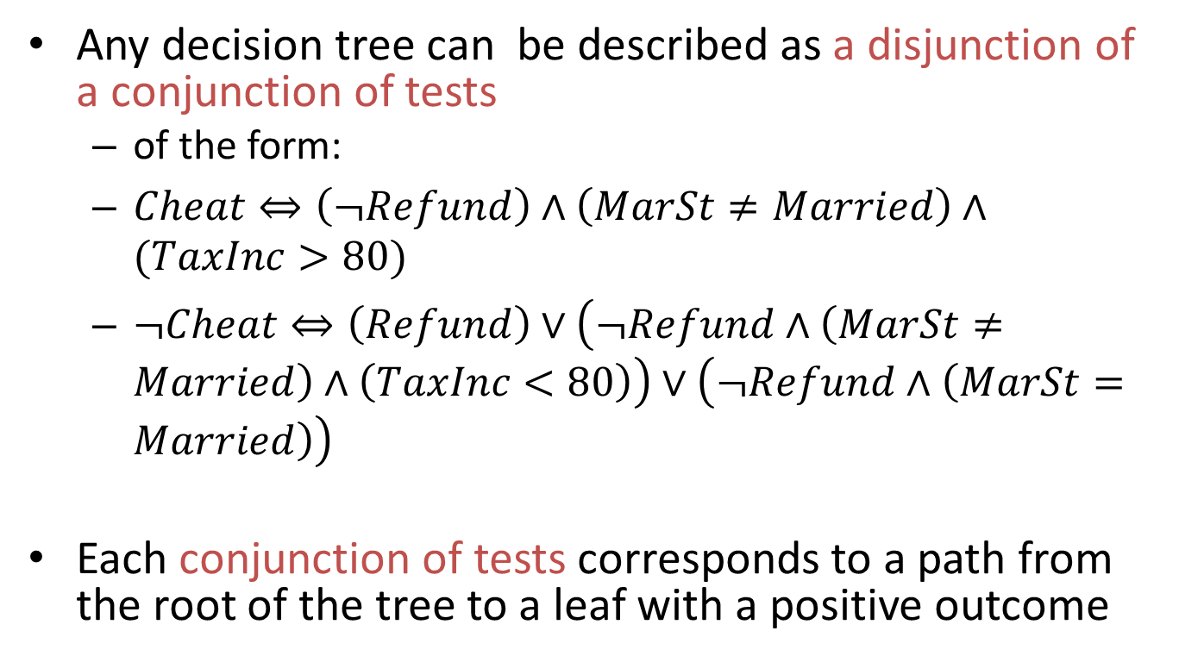
Expressiveness of Decision Trees
Any decision tree can be described as a disjunction of a conjunction of tests
of the form:
$Cheat⇔\left(¬Refund\right)∧\left(MarSt≠Married\right)∧(TaxInc>80)$
$¬Cheat⇔\left(Refund\right)∨\left(¬Refund∧\left(MarSt≠Married\right)∧\left(TaxInc<80\right)\right)∨\left(¬Refund∧\left(MarSt=Married\right)\right)$
Each conjunction of tests corresponds to a path from the root of the tree to a leaf with a positive outcome

Slide 16
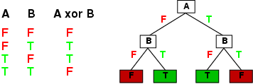
Expressiveness of Decision Trees
Decision trees can express any Boolean function of the input attributes.
E.g., for Boolean functions, truth table row → path to leaf:

Slide 17



Expressiveness of Decision Trees
A
A
A
T
F
T
F
T
F
B
B
B
B
B
B
T
F
T
F
T
F
T
F
T
F
T
F
T
F
T
T
F
F
T
T
F
T
F
F
$$\sim A∨B$$
$$¬A$$
$$A∧¬B$$

Slide 18



Expressiveness of Decision Trees
A
A
A
T
F
T
F
T
F
B
F
B
T
F
T
T
F
T
F
F
T
T
F
$$¬A$$
$$A∧¬B$$
$$\sim A∨B$$

Slide 19
Classwork
Create the smallest decision tree that you can to represent this function:
A | B | C | f(A,B,C)
false | false | false | NO
false | false | true | YES
false | true | false | NO
false | true | true | YES
true | false | false | NO
true | false | true | YES
true | true | false | NO
true | true | true | NO

Slide 20
Decision Tree Learning

Slide 21
Decision Tree Classification
Decision Tree

Slide 22
Example of a Decision Tree
categorical
categorical
continuous
class
Splitting Attributes
Refund
Yes
No
NO
MarSt
Single, Divorced
Married
TaxInc
NO
< 80K
> 80K
NO
YES
Training Data
Model: Decision Tree

Slide 23
Another Example of a Decision Tree
categorical
categorical
continuous
class
MarSt
Single, Divorced
Married
NO
Refund
Yes
No
NO
TaxInc
< 80K
> 80K
NO
YES
There could be more than one tree that fits the same data!

Slide 24
Decision tree learning
Decision Tree Induction
Finding a decision tree that agrees with data

Slide 25
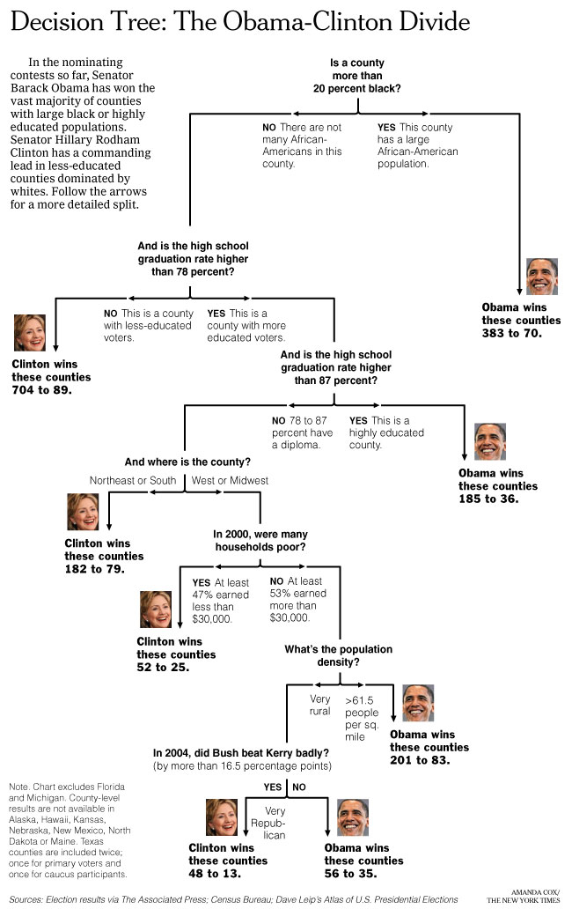
New York Times
April 16, 2008
How can we learn such a complex tree?

Slide 26
ID3 algorithm

Slide 27
A decision problem
Problem: decide whether to wait for a table at a restaurant, based on the following attributes:
1. Alternate: is there an alternative restaurant nearby?
2. Bar: is there a comfortable bar area to wait in?
3. Fri/Sat: is today Friday or Saturday?
4. Hungry: are we hungry?
5. Patrons: number of people in the restaurant (None, Some, Full)
6. Price: price range ($, $$, $$$)
7. Raining: is it raining outside?
8. Reservation: have we made a reservation?
9. Type: kind of restaurant (French, Italian, Thai, Burger)
10. WaitEstimate: estimated waiting time (0-10, 10-30, 30-60,>60)
Decision: WAIT or NOT WAIT (T/F)?

Slide 28
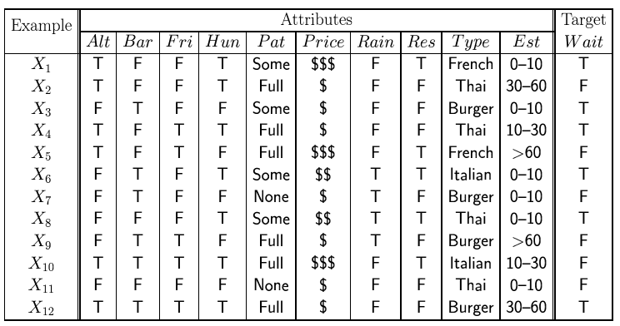
Training data
Examples described by attribute values (Boolean, discrete, continuous)
E.g., situations where I will/won't wait for a table at a restaurant:
Classification of examples is positive (T) or negative (F)
12 examples
6 +
6 -

Slide 29
Decision tree learning
Naïve approach
Construct a decision tree that has one path to a leaf for each example
Each path tests sets each attribute value to the value of the example
Problem: This just memorizes examples. What about new data? It doesn’t generalize
Prefer a compact/smallest tree

Slide 30
Decision tree learning
Prefer a compact/smallest tree
Occam’s Razor
“All other things being equal, choose the simplest explanation”
Find the smallest tree that classifies the data correctly
Problem
Finding the smallest tree consistent with the examples is NP-hard

Slide 31
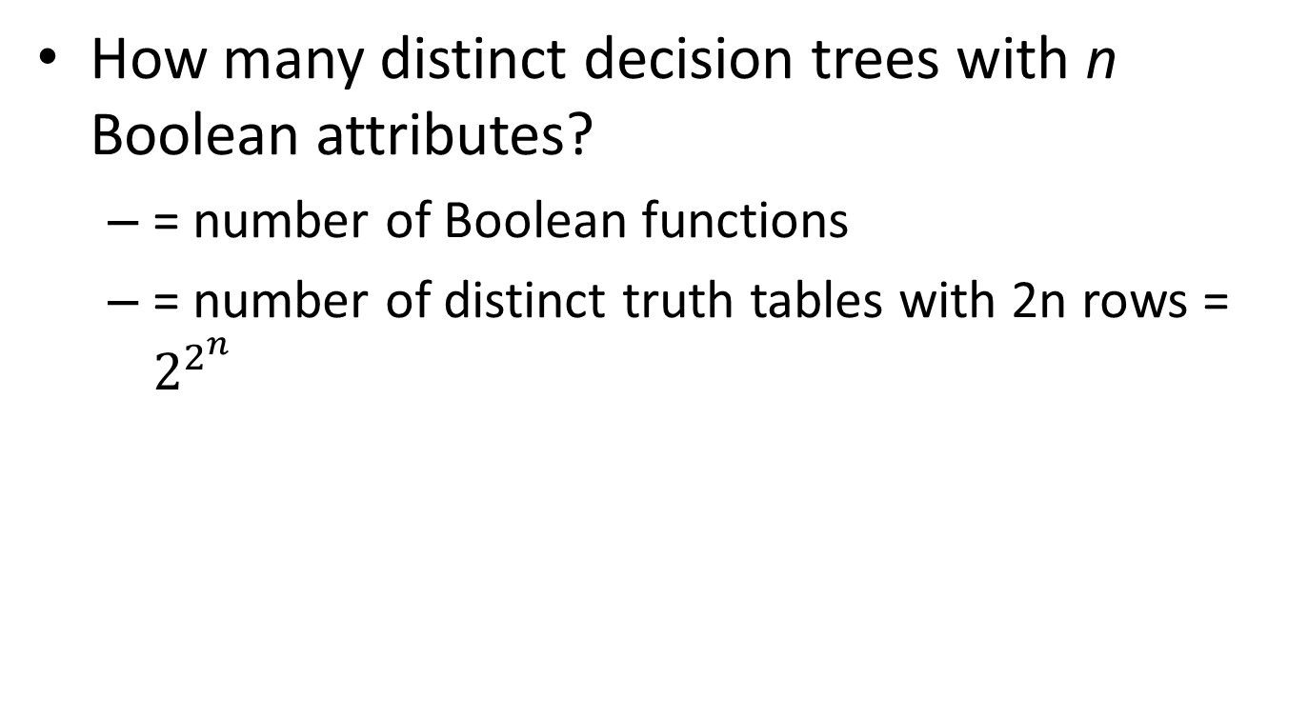
Size of hypothesis space
How many distinct decision trees with n Boolean attributes?
= number of Boolean functions
= number of distinct truth tables with 2n rows = $2^{2^{n}}$

Slide 32
Decision tree learning algorithm
Overall Goal: get a good classification with a small number of tests
Key problem:
Which attribute to test first?
Approach
Use heuristic search (greedy search)
Key idea:
Pick attribute that maximizes information as the root node

Slide 33
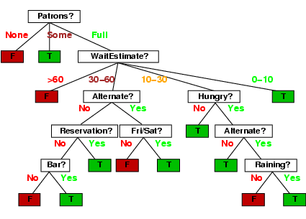
Decision tree

Slide 34
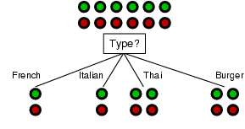
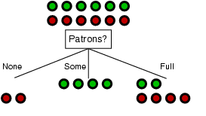
Choosing an attribute
Goal: trees with short paths to leaf nodes
Which one should we pick?
A perfect attribute would divide the examples into subsets that are all positive or all negative
maximum information gain

Slide 35
Information Gain
How to measure the “usefulness” of an attribute
how well attribute separates examples according to their labels (+/-)
Measure from Information Theory

Slide 36
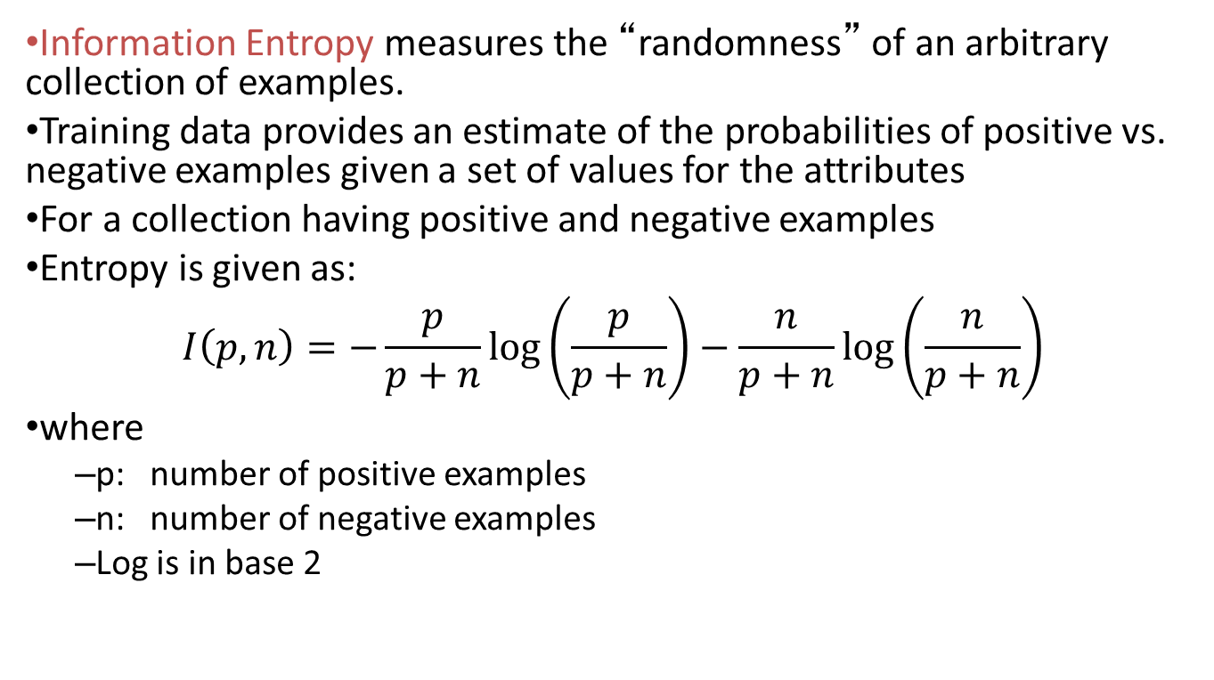
Information Entropy
Information Entropy measures the “randomness” of an arbitrary collection of examples.
Training data provides an estimate of the probabilities of positive vs. negative examples given a set of values for the attributes
For a collection having positive and negative examples
Entropy is given as:
$$I\left(p,n\right)=−\frac{p}{p+n}\log\left(\frac{p}{p+n}\right)−\frac{n}{p+n}\log\left(\frac{n}{p+n}\right)$$
where
p: number of positive examples
n: number of negative examples
Log is in base 2

Slide 37
Entropy of example dataset
Situations where I will/won't wait for a table:
What’s the entropy of this collection of examples?
p = 6; n = 6; I(6,6) = -0.5 log(0.5) –0.5 log(0.5) = 1
Need 1 bit of information to classify a randomly picked example from this data
12 examples
6 +
6 -

Slide 38
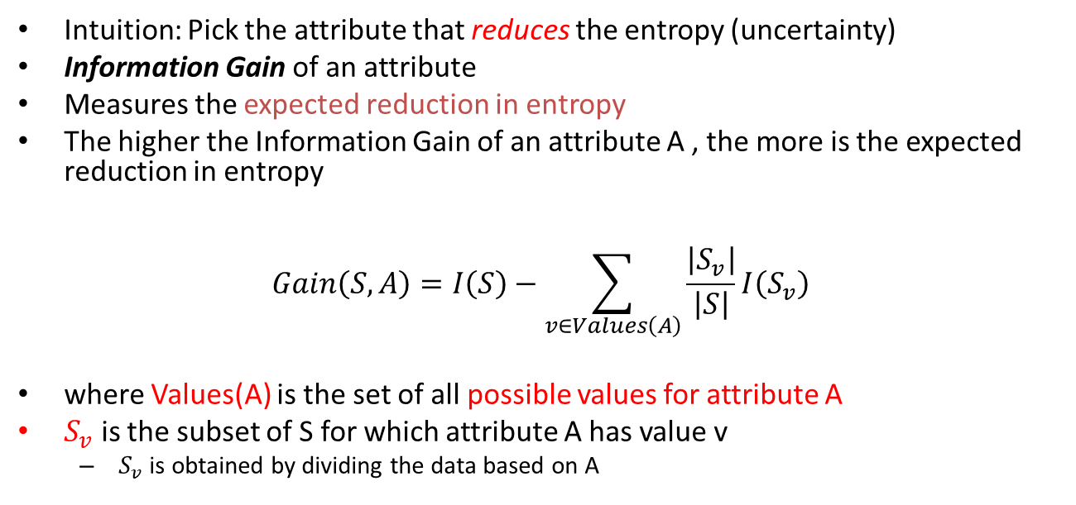
Information Gain
Intuition: Pick the attribute that reduces the entropy (uncertainty)
Information Gain of an attribute
Measures the expected reduction in entropy
The higher the Information Gain of an attribute A , the more is the expected reduction in entropy
$$Gain\left(S,A\right)=I\left(S\right)−\sum_{v∈Values\left(A\right)}{\frac{\left|S_{v}\right|}{\left|S\right|}I\left(S_{v}\right)}$$
where Values(A) is the set of all possible values for attribute A
$S_{v}$ is the subset of S for which attribute A has value v
$S_{v}$ is obtained by dividing the data based on A

Slide 39
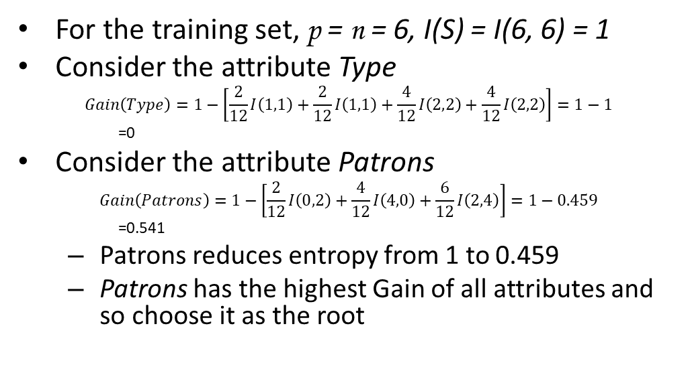
Information gain
For the training set, p = n = 6, I(S) = I(6, 6) = 1
Consider the attribute Type
$$Gain\left(Type\right)=1−\left[\frac{2}{12}I\left(1,1\right)+\frac{2}{12}I\left(1,1\right)+\frac{4}{12}I\left(2,2\right)+\frac{4}{12}I\left(2,2\right)\right]=1−1$$
=0
Consider the attribute Patrons
$$Gain\left(Patrons\right)=1−\left[\frac{2}{12}I\left(0,2\right)+\frac{4}{12}I\left(4,0\right)+\frac{6}{12}I\left(2,4\right)\right]=1−0.459$$
=0.541
Patrons reduces entropy from 1 to 0.459
Patrons has the highest Gain of all attributes and so choose it as the root

Slide 40
Classwork
Compute whether Hungry or Type is the better attribute after Patrons is made the root
Patrons?
None
Full
Some
?
?
Hungry? or Type?

Slide 41
Classwork solution
Hungry:
True: (2,2)
False(0,2)
Expected Information = (4/6)*I(2,2) + (2/6)*I(0,2)=0.667
Hun | Wait
T | F
T | T
F | F
F | F
T | F
T | T
Type | Wait
Thai | F
Thai | T
French | F
Burger | F
Italian | F
Burger | T
Type:
Thai: (1,1)
French(0,1)
Burger: (1,1)
Italian: (0,1)
Expected Information = (2/6)*I(1,1) + (1/6)*I(0,1) + (2/6)*I(1,1) + (1/6)*I(0,1)=0.667

Slide 42
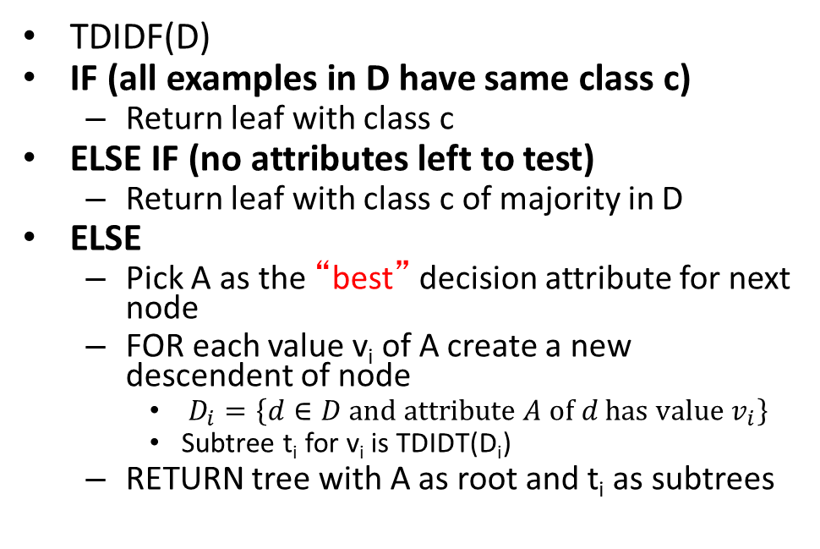
Recursive algorithm for DT induction
TDIDF(D)
IF (all examples in D have same class c)
Return leaf with class c
ELSE IF (no attributes left to test)
Return leaf with class c of majority in D
ELSE
Pick A as the “best” decision attribute for next node
FOR each value v_{i} of A create a new descendent of node
$D_{i}=\left\{d∈D and attribute A of d has value v_{i}\right\}$
Subtree t_{i} for v_{i} is TDIDT(D_{i})
RETURN tree with A as root and t_{i} as subtrees

Slide 43
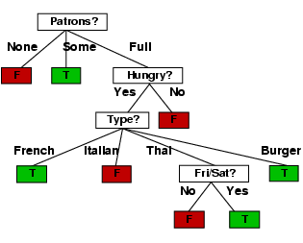
Decision tree learned from the 12 examples

Slide 44
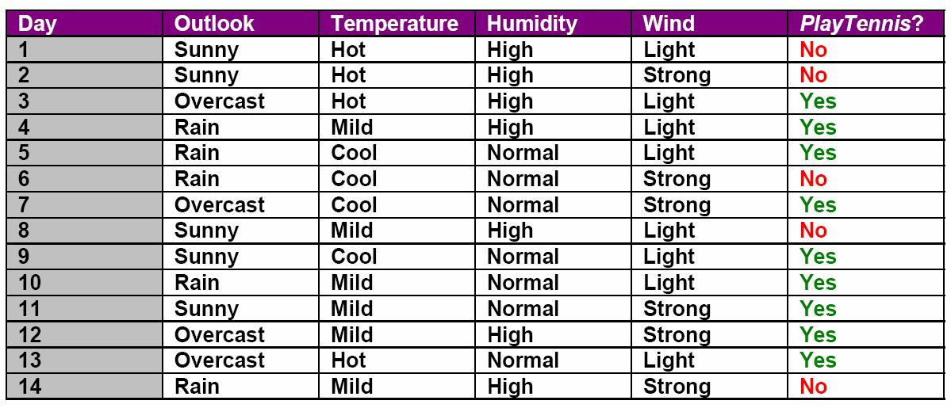
Another example
Which feature (Outlook, Temperature, Humidity, or Wind) is most important to decide if PlayTennis is Yes or No using the principle of Information Gain?

Slide 45
ID3 Algorithm
The entropy-based method is called the ID3 algorithm
Developed in 1986

Slide 46
Inductive Bias
ID3 algorithm prefers
shorter trees over deeper/more complex ones
ones with high gain attributes near root

Slide 47
Problems with ID3
ID3 is not optimal
Does not consider all combinations of parameters
Commits to some at the beginning itself
Must use discrete (or discretized) attributes
Must break down continuous attributes into a set of discrete ranges

Slide 48
ID3 summary
Advantages
Easy to implement, convert a decision tree into rules, understand, and use.
Computationally cheap
Relatively robust to noisy data (since it is based on probabilistic decision making)
Common issues
Problem of continuous variables (infinite number of split values)
Overfitting
Large data set may produce a large tree (difficult to understand).
Non-incremental learning (e.g., not good for online learning)
Use only one attribute at a time while a test condition may involve multiple attributes, e.g., A₁+A₂ > 20 then class 1 else class 0.
Finding optimal test condition is computationally expensive.
Same subtrees may appear in multiple branches.
Many variations to deal with some of these issues
C4.5, CART, CHAID, MARS, Conditional inference trees, etc.

Slide 49
CART algorithm

Slide 50
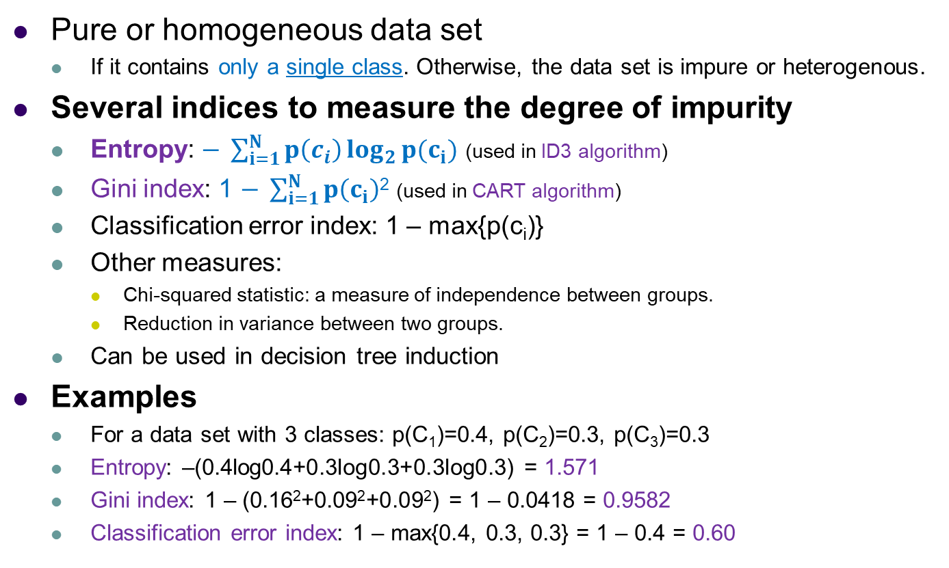
Measuring Impurity (non-Homogeneity)
Pure or homogeneous data set
If it contains only a single class. Otherwise, the data set is impure or heterogenous.
Several indices to measure the degree of impurity
Entropy: $− \sum_{i=1}^{N}{p\left(c_{i}\right)\log_{2}{p(c_{i})}}$ (used in ID3 algorithm)
Gini index: 1 $− \sum_{i=1}^{N}{p\left(c_{i}\right)}$² (used in CART algorithm)
Classification error index: 1 – max{p(c_{i})}
Other measures:
Chi-squared statistic: a measure of independence between groups.
Reduction in variance between two groups.
Can be used in decision tree induction
Examples
For a data set with 3 classes: p(C₁)=0.4, p(C₂)=0.3, p(C₃)=0.3
Entropy: –(0.4log0.4+0.3log0.3+0.3log0.3) = 1.571
Gini index: 1 – (0.16²+0.09²+0.09²) = 1 – 0.0418 = 0.9582
Classification error index: 1 – max{0.4, 0.3, 0.3} = 1 – 0.4 = 0.60

Slide 51
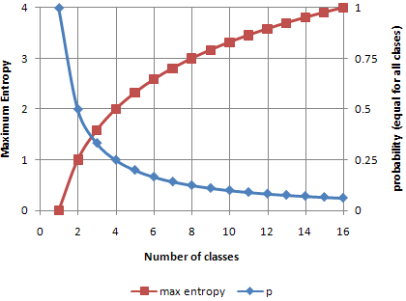
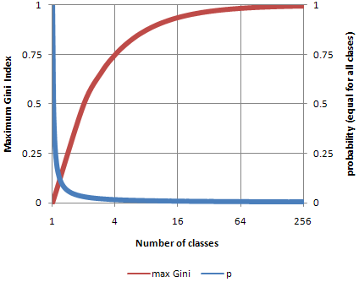
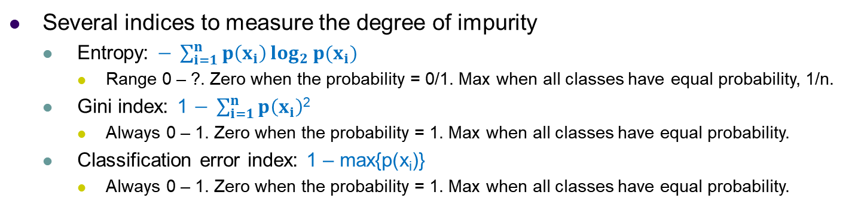
Measuring Impurity (non-Homogeneity)
Several indices to measure the degree of impurity
Entropy: $− \sum_{i=1}^{n}{p\left(x_{i}\right)\log_{2}{p(x_{i})}}$
Range 0 – ?. Zero when the probability = 0/1. Max when all classes have equal probability, 1/n.
Gini index: 1 $− \sum_{i=1}^{n}{p\left(x_{i}\right)}$²
Always 0 – 1. Zero when the probability = 1. Max when all classes have equal probability.
Classification error index: 1 – max{p(x_{i})}
Always 0 – 1. Zero when the probability = 1. Max when all classes have equal probability.

Slide 52


Dealing with Continuous Variables
Possible solutions: Discretize the continuous values
Binary split, one branch X<t, other branch X≥t where t is a threshold value.
Searching for possible values of t seems hard but only a relatively small number are important:
Sort the data by X and put them into {x₁,…,x_{m}} and consider split points of the form x_{i}+(x_{i+1} – x_{i})/2
Only splits between examples of different classes (called decision stump) matter! Choose a threshold value θ to determine the class, e.g., +1 if x_{i} > θ, -1 if x_{i} ≤ θ.
Picking the best value of t based on the information gain
From H(Y|X:t) = P(X < t)H(Y|X < t) + p(X ≥ t)H(Y|X ≥ t), compute
IG(Y, X:t) = H(Y) – H(Y|X:t) and find t = argmax_{t}(IG(Y, X:t))

Slide 53
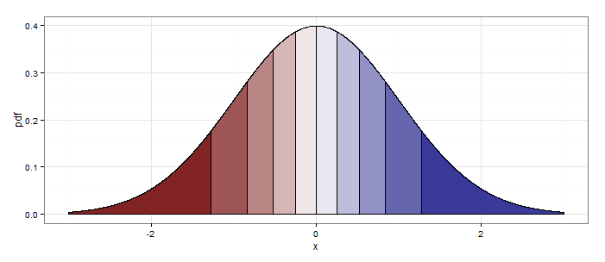
Dealing with Continuous Variables
Feature discretization
Equal width bins with open ends
Equal density bins (quantiles)
Centered between each sign change
-----+--+-+--++-+++-+++++++
Bisection: (X₁ < -0.5)
Range: (1 < X₁ ≤ 3)
Relational: (X₁ – X₂ < -0.5)
Missing: (X₁ = NaN) or (X₁ = mode) or False/True value strategy
Hierarchical: country > state > city > neighborhood

Slide 54
CART algorithm
Classification and Regression Tree (CART)
Creates binary trees
Recursive algorithm
At every step, split the training data into two subsets using a single feature (and split value)
Select feature using sum of the Gini index of the two subsets, weighted by size
Intuition: split to get “purest” subsets
Stop when not possible to reduce impurity
Default algorithm in scikit-learn’s DecisionTree classes

Slide 55
Class work
Load the autompg.csv dataset
Use scikit-learn DecisionTreeClassifier to learn a decision tree to classify Cylinders based on the other features
Drop the last column (model name)
Visualize the decision tree (see textbook code)

Slide 56
Overfitting in decision trees

Slide 57
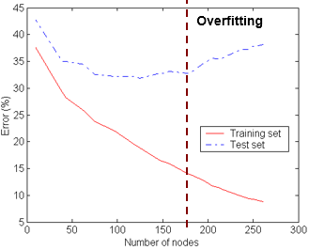
Detecting Overfitting
Standard decision tree will overfit as the decision tree has no learning bias (training error = 0 unless noise added).
Training error no longer provides a good estimate of how well the tree will perform on previously unseen data.
Problems of overfitting
Tree growth too far and # of examples for a branch gets smaller (leaves match only single example), resulting in a complex tree (hard to understand)
Entropy shrinks, reducing bias but variance may increase, results in misclassification.
Avoid overfitting
We want to minimize the size of tree and misclassification rate.
Some methods: pre- or -post pruning, bagging, etc.

Slide 58
Pre-pruning to Avoid Overfitting
Idea:
Stop training before it becomes a fully-grown tree (early stopping), penalizing complex trees.
Typical stopping conditions:
All instances belong to the same class.
All the attribute values are the same.
What to do if two or more examples have the same attribute values but different classes? This is an error/noise. Stop and use the majority vote.
More restrictive stopping conditions:
The tree grows to a fixed depth (ad hoc solution).
# of examples is less than a threshold value.
Information gain is smaller than a threshold or impurity measure doesn’t improve (In this case, post pruning may be better.)
Class distribution of examples are independent of the available features, e.g., using a chi-squared test.

Slide 59
Post-pruning to Avoid Overfitting
Idea:
Grow a full decision tree and prune later to generalize the tree.
Post pruning process
Split dataset into training and validation sets (different from test set).
Grow full decision tree on the training set.
Some pruning conditions:
Class distribution of examples are independent of the available features (can check with chi-squared test).
The parent error is smaller than children (subtree) error based on the validation set.
Prune the tree until further pruning is harmful:
If pruning conditions = True, Replace the root of a subtree by a leaf labeled with the majority class for that subtree or by the class that most increases validation set accuracy (greedy approach).
Evaluate the impact of pruning each subtree.
Post-pruning vs pre-pruning
Post pruning in general seems better than pre-pruning because it is not easy to estimate when to stop growing the tree.

Slide 60
Reducing overfitting by rule simplification
Every decision tree corresponds to set of rules:
IF (Patrons = None)
THEN WillWait = No
IF (Patrons = Full) & (Hungry = No) &(Type = French)
THEN WillWait = Yes
...

Slide 61
From Decision Trees To Rules
Rules are mutually exclusive and exhaustive
Rule set contains as much information as the tree

Slide 62
Rules Can Be Simplified
Initial Rule: (Refund=No) ∧ (Status=Married) → No
Simplified Rule: (Status=Married) → No

Slide 63
Classwork
Write the rule(s) that describe the longest path in this decision tree
For this rule, list all the simplifications

Slide 64
Pruning a tree to improve generalization
Build a decision tree using all the data
Convert decision tree to equivalent set of rules
One rule per path from root to leaf
Prune (generalize) each rule independent of the others
Delete preconditions that improve its accuracy
Sort simplified rules by giving a priority to each rule
Simplified rules may not be mutually exclusive
More than one rule may apply for a given set of attributes
Use sorted rule set for classification

Slide 65
Pruning a tree to improve generalization
Strategy of one of the most successful decision tree learning algorithm
C4.5
Widely used in Data Mining

Slide 66
Interpretable ML
Slides by Greg Harris, USC

Slide 67









Bio
Work experience:
Education:
Next stop:
Dr. Panangadan was my postdoc
Physics
Financial Mathematics
Computer Science
Quantitative commodity futures trading

Slide 68
Interpretable Machine Learning
Why is interpretability important in machine learning?
Especially since interpretable models often have lower accuracy than black-boxes

Slide 69
Informativeness
Imparting knowledge in a way humans can understand
Providing evidence and assistance to human decision makers
Data mining = knowledge discovery, not automation
Example: choosing where to place items in a grocery store
Predict whether an item will be purchased given other items in basket
Indirect use of machine learning (actual prediction has no value)

Slide 70
Trust
Many people don’t naturally trust machine learning models
“Trust in a system is developed not only by the quality of its results, but also by clear description of how they were derived.”
Swartout, W. R. (1983). XPLAIN: A system for creating and explaining expert consulting programs. Artificial intelligence, 21(3), 285-325.

Slide 71
Trust
Pejorative sense of “data mining” = selectively trying to find data to support a particular hypothesis
Multiple testing or multiple comparison problem
Reduces statistical significance
Increases false discovery rate
Interpretability is one tool for identifying over-fitting

Slide 72
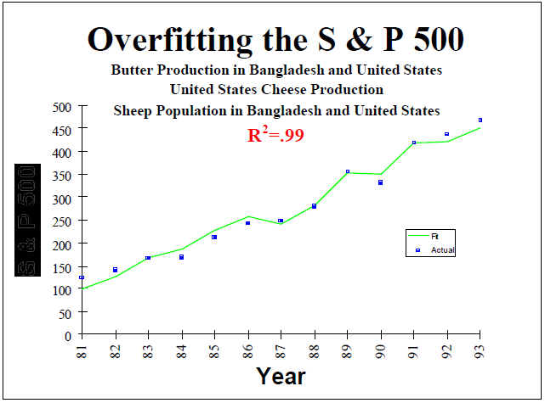
Trust

Slide 73
Trust
Leinweber, D. J. (2007). Stupid data miner tricks: Overfitting the S&P 500. The Journal of Investing, 16(1), 15-22.

Slide 74
Causality
Machine learning models can only find associative relationships
Causality can only be determined through scientific investigation and controlled experimentation
Interpretable models suggest relationships which can then be tested
Causal relationships are more interesting:
Alter, and not just predict, website visitor’s actions
Cure, and not just diagnose, hospital patient’s illness

Slide 75


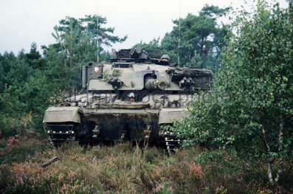

Transferability
Models can be brittle when used in new environments
Humans are good at knowing what will/won’t transfer
Tank example
Transferability of learned associations is important in situations where actions influenced by a model alter the environment
Predicting death for pneumonia patients with asthma example

Slide 76
Interpretable Machine Learning
What are ways machine learning can be interpretable?

Slide 77
Comprehensibility
Can the model be simulated in the mind?
Within reasonable time, can a person recreate the prediction process?
How hard is it to tell the equivalence of two models?
Comprehensible:
Decision trees
Classification rules
Linear models
Incomprehensible:
Deep neural networks
Kernelized support vector machines
Random forests
Ensemble methods

Slide 78
Decompositionality
Can a complex model be decomposed into parts that make sense?
Requires features that are sensible instead of highly engineered or anonymous

Slide 79
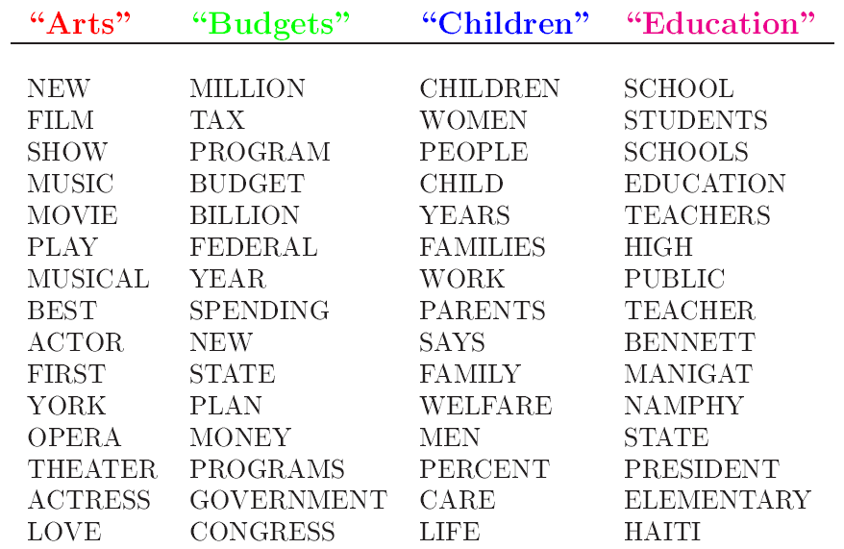
Post-hoc Interpretability
Maintain accuracy while providing some explanation
Example: Case-based explanations – k-NN (Medicine)
Example: Latent Dirichlet Allocation

Slide 80
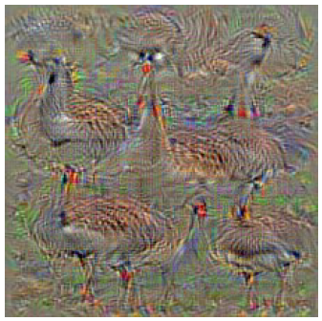
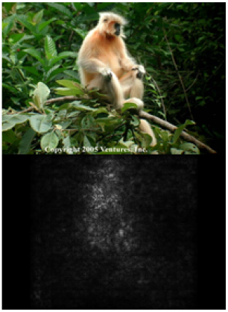
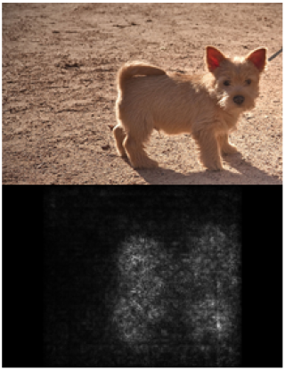
Post-hoc Interpretability
Example: Class saliency maps
Used in image classification with convolutional neural networks
Highlight areas of image most discriminative w.r.t. given class

Slide 81
Regression Trees

Slide 82
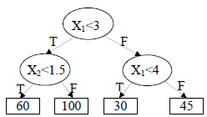
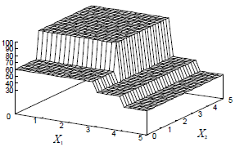

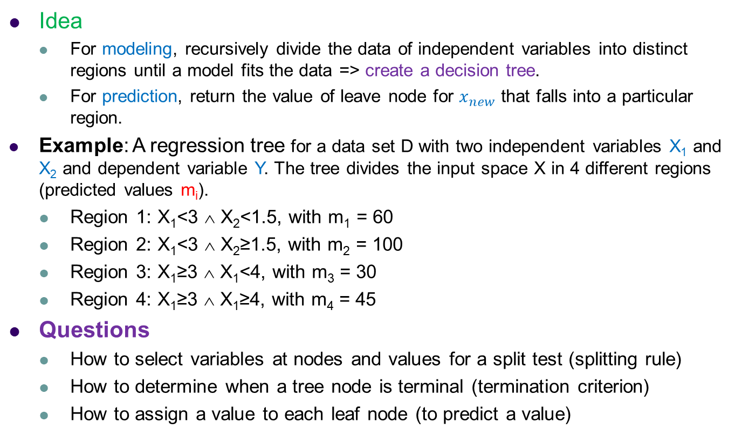
Regression Tree
Idea
For modeling, recursively divide the data of independent variables into distinct regions until a model fits the data => create a decision tree.
For prediction, return the value of leave node for $x_{new}$ that falls into a particular region.
Example: A regression tree for a data set D with two independent variables X₁ and X₂ and dependent variable Y. The tree divides the input space X in 4 different regions (predicted values m_{i}).
Region 1: X₁<3 ∧ X₂<1.5, with m₁ = 60
Region 2: X₁<3 ∧ X₂≥1.5, with m₂ = 100
Region 3: X₁≥3 ∧ X₁<4, with m₃ = 30
Region 4: X₁≥3 ∧ X₁≥4, with m₄ = 45
Questions
How to select variables at nodes and values for a split test (splitting rule)
How to determine when a tree node is terminal (termination criterion)
How to assign a value to each leaf node (to predict a value)

Slide 83
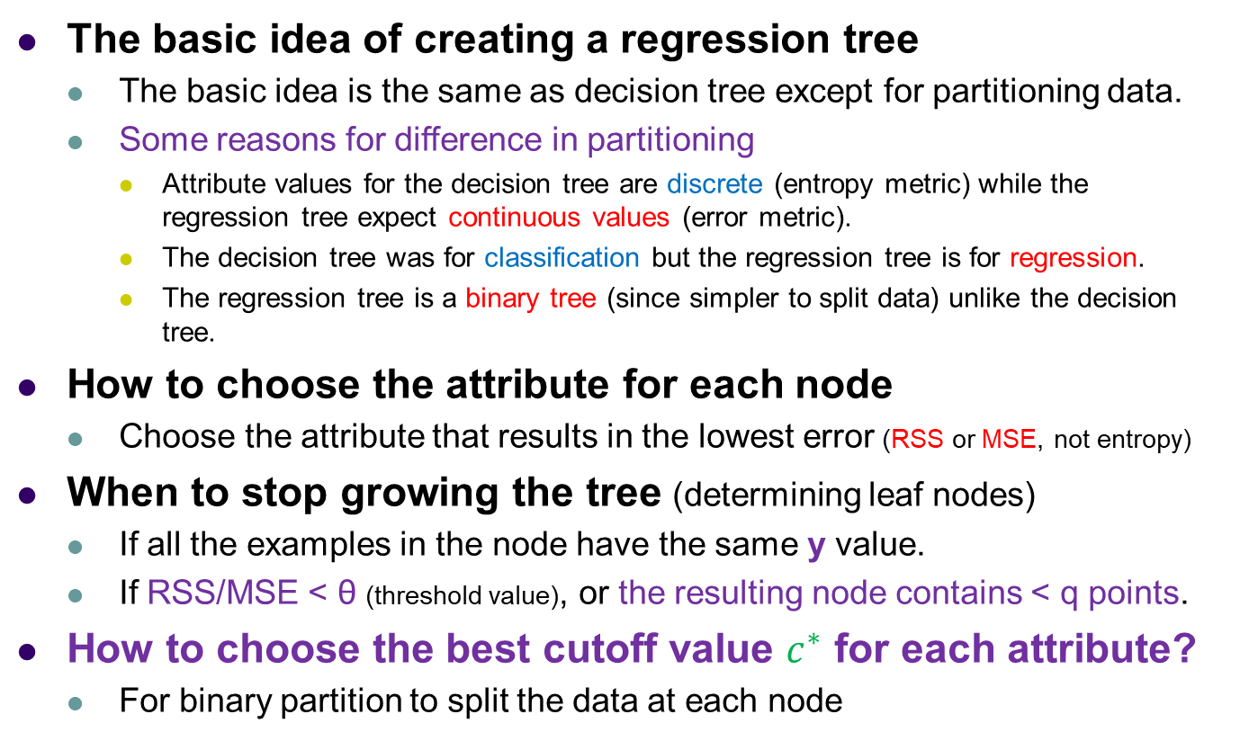
Creating a Regression Tree (Classification and Regression Tree (CART), Breiman et al. 1984)
The basic idea of creating a regression tree
The basic idea is the same as decision tree except for partitioning data.
Some reasons for difference in partitioning
Attribute values for the decision tree are discrete (entropy metric) while the regression tree expect continuous values (error metric).
The decision tree was for classification but the regression tree is for regression.
The regression tree is a binary tree (since simpler to split data) unlike the decision tree.
How to choose the attribute for each node
Choose the attribute that results in the lowest error (RSS or MSE, not entropy)
When to stop growing the tree (determining leaf nodes)
If all the examples in the node have the same y value.
If RSS/MSE < θ (threshold value), or the resulting node contains < q points.
How to choose the best cutoff value $c^{∗}$ for each attribute?
For binary partition to split the data at each node

Slide 84
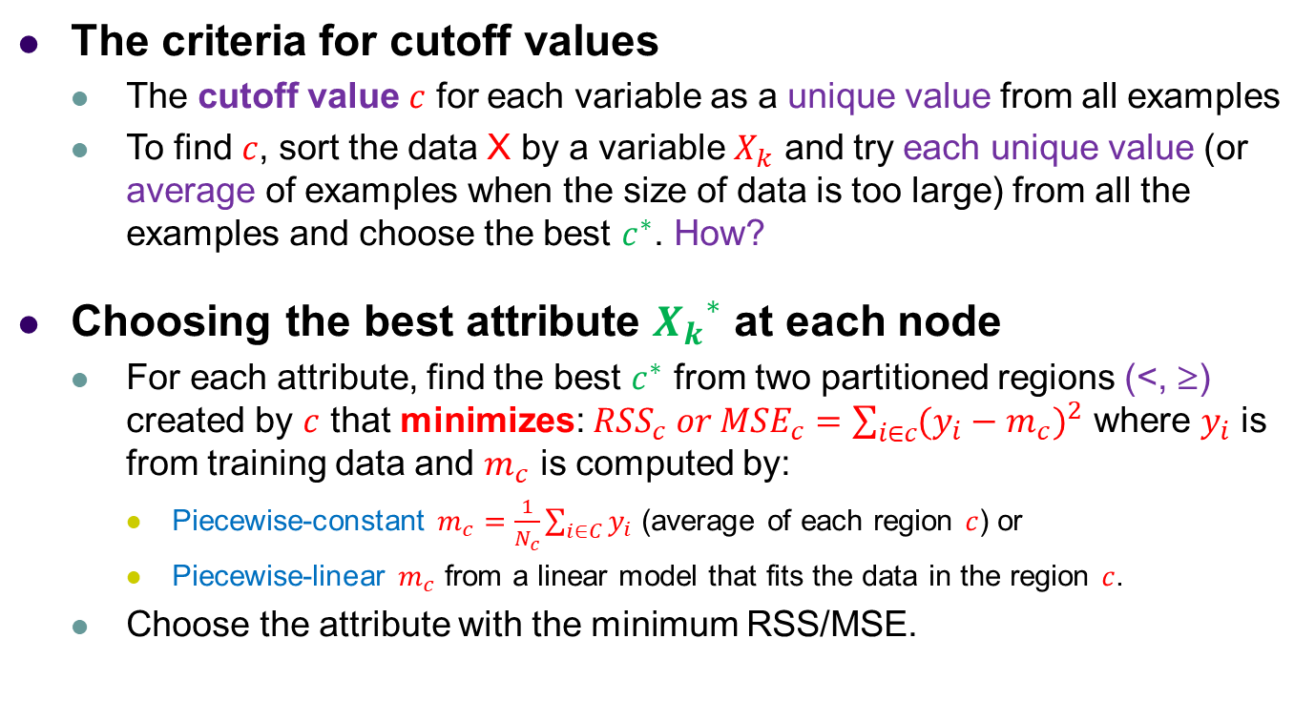
Creating a Regression Tree (Classification and Regression (CART), Breiman et al. 1984)
The criteria for cutoff values
The cutoff value $c$ for each variable as a unique value from all examples
To find $c$, sort the data X by a variable $X_{k}$ and try each unique value (or average of examples when the size of data is too large) from all the examples and choose the best $c^{∗}$. How?
Choosing the best attribute ${X_{k}}^{∗}$ at each node
For each attribute, find the best $c^{∗}$ from two partitioned regions (<, ≥) created by $c$ that minimizes: ${RSS}_{c} or {MSE}_{c}=\sum_{i∈c}{{(y_{i}−m_{c})}^{2}}$ where $y_{i}$ is from training data and $m_{c}$ is computed by:
Piecewise-constant $m_{c}=\frac{1}{N_{c}}\sum_{i∈C}{y_{i}}$ (average of each region $c$) or
Piecewise-linear $m_{c}$ from a linear model that fits the data in the region $c$.
Choose the attribute with the minimum RSS/MSE.

Slide 85
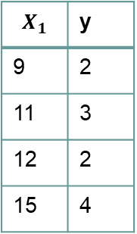
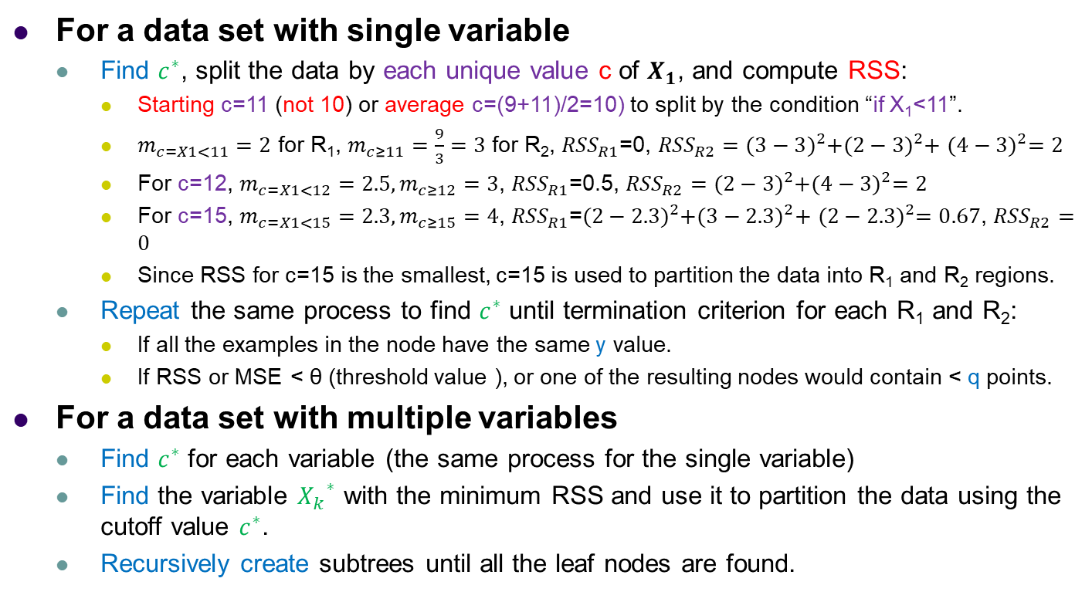
Example: Regression Tree
$$X_{1}$$ | y
9 | 2
11 | 3
12 | 2
15 | 4
For a data set with single variable
Find $c^{∗}$, split the data by each unique value c of $X_{1}$, and compute RSS:
Starting c=11 (not 10) or average c=(9+11)/2=10) to split by the condition “if X₁<11”.
$m_{c=X1<11}=2$ for R₁, $m_{c≥11}=\frac{9}{3}=3$ for R₂, ${RSS}_{R1}$=0, ${RSS}_{R2}={(3−3)}^{2}+{(2−3)}^{2}+$ ${(4−3)}^{2}=2$
For c=12, $m_{c=X1<12}=2.5, m_{c≥12}=3$, ${RSS}_{R1}$=0.5, ${RSS}_{R2}={(2−3)}^{2}+{(4−3)}^{2}=2$
For c=15, $m_{c=X1<15}=2.3, m_{c≥15}=4$, ${RSS}_{R1}$=${(2−2.3)}^{2}+{(3−2.3)}^{2}+$ ${(2−2.3)}^{2}=0.67$, ${RSS}_{R2}=0$
Since RSS for c=15 is the smallest, c=15 is used to partition the data into R₁ and R₂ regions.
Repeat the same process to find $c^{∗}$ until termination criterion for each R₁ and R₂:
If all the examples in the node have the same y value.
If RSS or MSE < θ (threshold value ), or one of the resulting nodes would contain < q points.
For a data set with multiple variables
Find $c^{∗}$ for each variable (the same process for the single variable)
Find the variable ${X_{k}}^{∗}$ with the minimum RSS and use it to partition the data using the cutoff value $c^{∗}$.
Recursively create subtrees until all the leaf nodes are found.

Slide 86
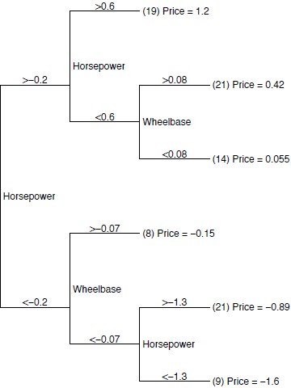
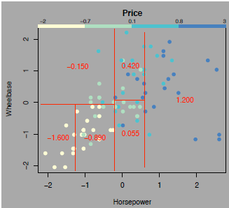
Example: Regression Tree
The X-space (independent variables) is partitioned into disjoint regions.
The partition of the data implied by the regression tree.
Note: All the dividing lines are parallel to the axes, because each internal node checks whether a single variable is above or below a given value.
A regression tree for the prices of 1993-model cars. All features have been standardized to have zero mean and unit variance.

Slide 87
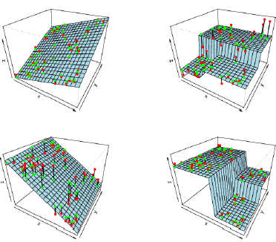
Linear Regression vs Regression Tree
Linear regression
Regression tree is a nonparametric method.

Slide 88
Pros and Cons of Regression Tree
Advantages
Easy to understand which variables are important in making the prediction.
Even if some data is missing, still possible to make predictions by averaging all the leaves in the subtree.
Can even work when the true regression surface is not smooth.
Fast and reliable algorithms to learn the regress trees.
Disadvantages
Does not give precise continuous nature predictions.
Doesn’t predict beyond the range in the training data.
May overfit data sets that are particularly noisy.

Slide 89
Textbook code
Textbook code
Textbook code on Google Colab
Open 06_decision_trees.ipynb

Slide 90
Acknowledgement
Many slides from Dr. Christopher Ryu
Content based on “Hands-On Machine Learning with Scikit-Learn, Keras, and TensorFlow,” Aurélien Géron, 3rd Edition (October 2022), O'Reilly Media, Inc.

